Slide 1


PRESENTATION - MYSQL
By Jawad Ahmed

Slide 2
Introduction
MySQL uses Relational Database Model
Stores data in tables (rows & columns)
Notes:
MySQL is an open-source database management system.
It uses a relational model, which means data is organized into tables.
Each table represents an entity and stores records as rows.
It is widely used in web development and business applications.

Slide 3
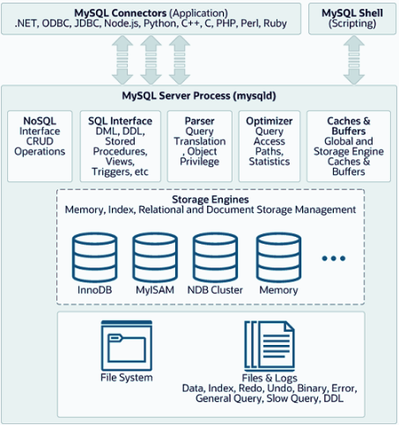
MySQL Architecture Diagram
Fig 1.1: MySQL Architecture Diagram
Notes:
🔷 1. Top Layer – MySQL Interfaces
MySQL Connectors allow applications (in languages like Python, Java, PHP, etc.) to communicate with the MySQL server.
MySQL Shell provides scripting capabilities for advanced database operations and management.
🔷 2. MySQL Server Process (mysqld)
This is the core service that handles all database tasks. Inside it:
NoSQL Interface: Allows CRUD operations via Document Store (MySQL also supports NoSQL features).
SQL Interface: Supports standard SQL operations such as:
DML (INSERT, UPDATE, DELETE)
DDL (CREATE, ALTER)
Views, Stored Procedures, and Triggers
Parser & Translator:
Parses the query and checks its syntax
Translates it into a form that can be executed
Optimizer:
Finds the fastest way to execute a query using statistics and indexes
Caches & Buffers:
Stores frequent queries, data, and index blocks for faster access
🔷 3. Storage Engines
These manage how data is stored and retrieved:
InnoDB: Default engine; supports transactions, foreign keys
MyISAM: Older engine, faster reads, no transaction support
NDB Cluster: For distributed systems
Memory: Stores data in RAM, used for fast temporary tables
🔷 4. File System & Logs:
Files & Logs store:
Actual data files
Redo/Undo logs (used for recovery)
Error logs, general logs, binary logs
Slow query logs
DDL commands history
Q&A
mysqld is the heart of MySQL that handles queries, optimizations, and storage.
Connectors allow multiple programming languages to connect to MySQL.
Storage engines are interchangeable and handle data differently based on needs.
Logs and files ensure data safety, recovery, and performance tracking.

Slide 4
Advantages
Structured & Organized data storage
Supports ACID properties (reliable transactions)
Notes:
MySQL’s relational model ensures clear data structure and reduces redundancy.
ACID stands for Atomicity, Consistency, Isolation, and Durability – ensuring safe and accurate transactions.
Relationships help maintain data integrity through foreign key constraints.

Slide 5
Disadvantages
Not ideal for unstructured data
Complex joins can slow performance
Notes:
MySQL struggles with unstructured data like images, videos, or large documents.
When you query large data using many joins, performance may drop.
Scaling horizontally (across many servers) is harder compared to NoSQL.

Slide 6
Conclution
MySQL is powerful and reliable for structured data
Great choice for small to medium projects
Notes:
MySQL is widely used due to its simplicity, speed, and open-source nature.
It's a strong solution when your data fits well in tables and relationships.
For real-time apps or massive scaling, other models (like NoSQL) may be more suitable.

Slide 7

Questions

Slide 8
THANK YOU
For Focusing on Lecture

